Slide 1
Wrangling biological datasets
Week 2, Computational Genomics
Notes:
Objective of this lesson: Students should be able to…
Describe the data generation process in genomics studies and which aspect of the data we are focusing on in this course.
Describe what the observations, variables, and values represent in a genomics dataset.
Carry out subsetting on observations and variables in dataframes using base-R: $, [,] which(), boolean statements. Understand that filter() and select() as functional alternatives.
Carry out new variable creation using mutate() or $.
Contrast environment and data variables.
Describe situations in which the observation needed is encoded by other variables in the dataframe.
Carry out group_by() and summarize() functions to collapse a dataframe to the observation desired defined by other variables in the dataframe, and specify new variables by summarizing existing variables.
Describe situations in which the variables needed is in two separate dataframes with same type of observations, and identify which common variable and join() function is needed.
Carry out join() functions to intersect two dataframes, using a common variable.
Check whether one’s data wrangling process is correct using simple functions and observation/variable/values framework.
Assemble a chain of functions to get a dataframe to a position that is ready to answer particular question.
Contrast () vs. %>% method of composing functions, and translate one method to the other.

Slide 2
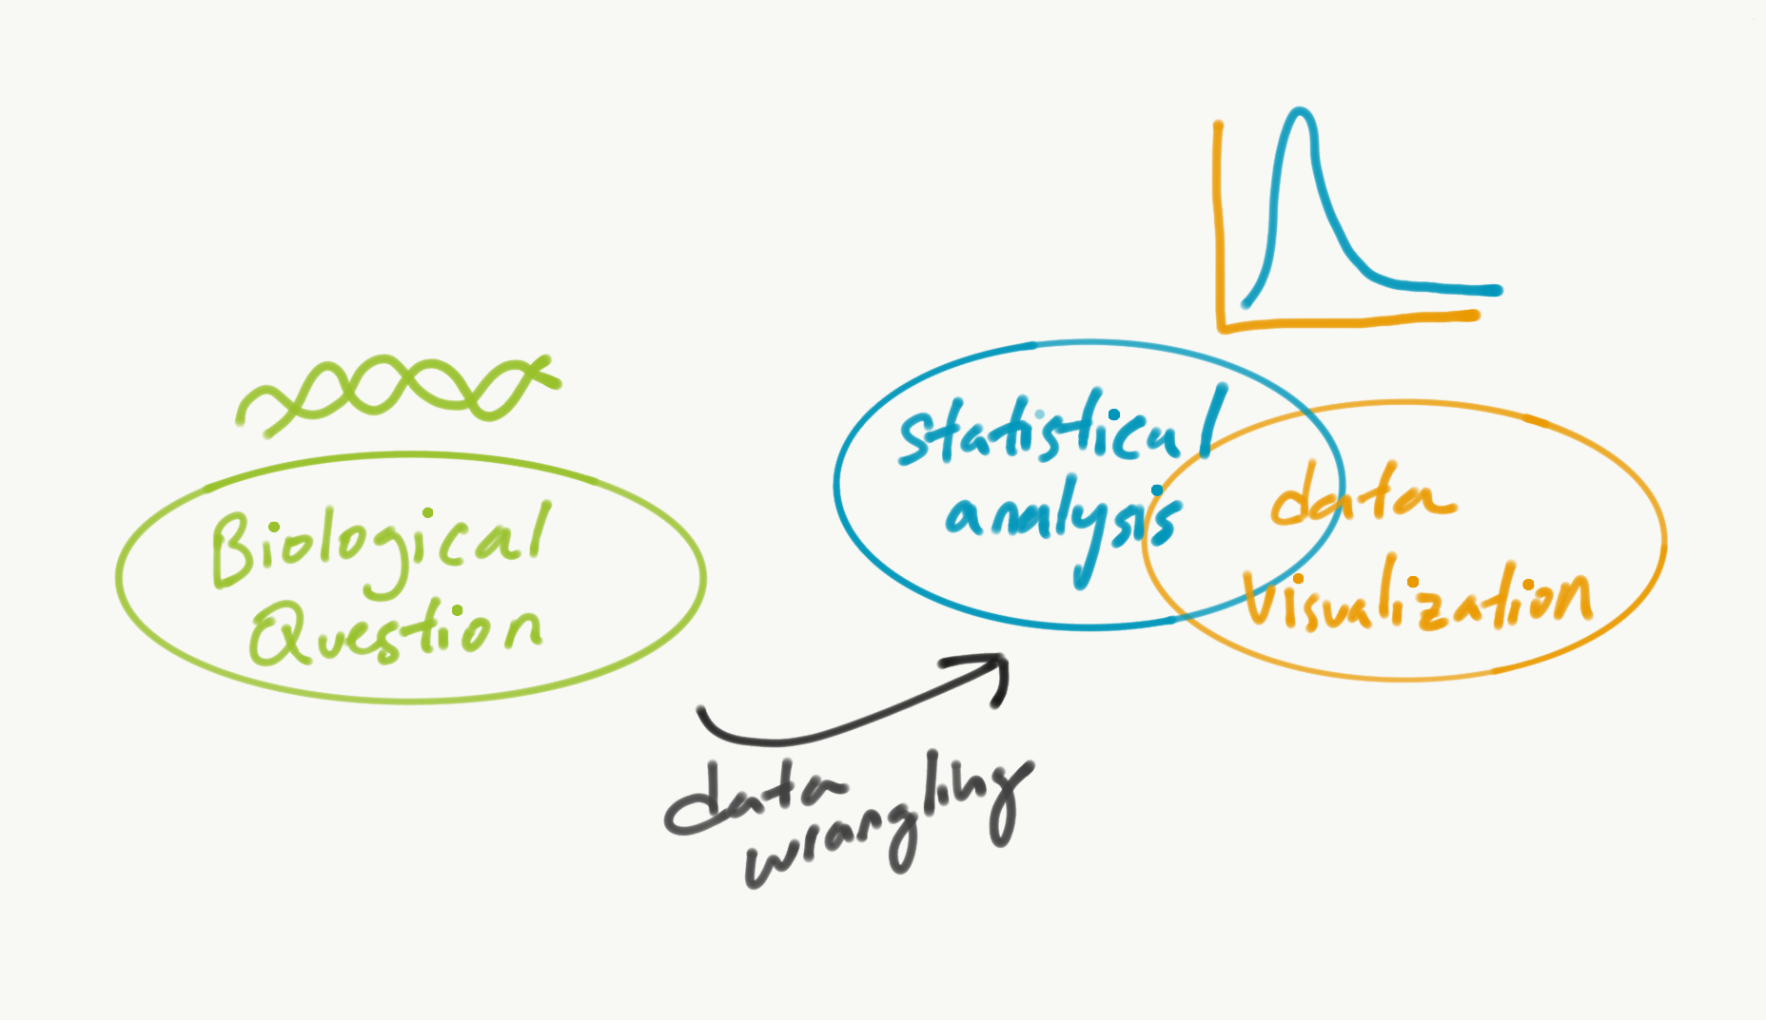
Wrangling biological datasets

Slide 3
Wrangling biological datasets
What are some common formats of genomics data (metadata, mutations, and gene expression)?
What kind of format does it need to be “wrangled” for analysis?
What are the tools (functions)?
Notes:
What other 80-20 rules are you familiar with?

Slide 4
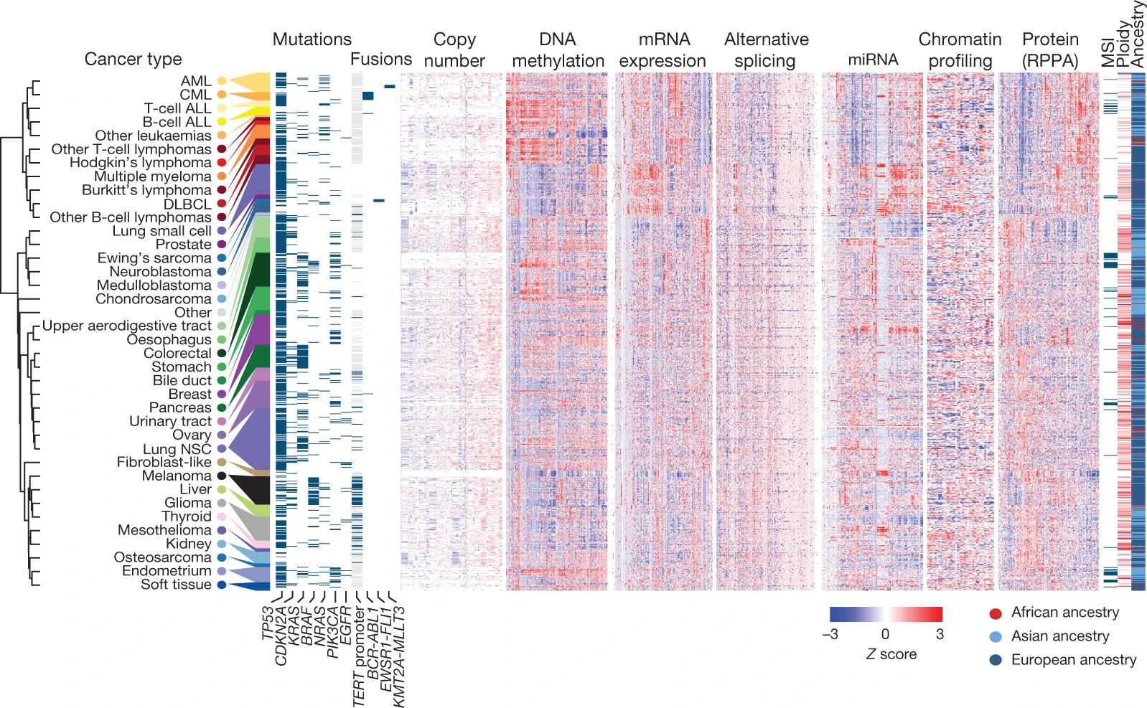
Three dataframes this week
metadata
mutation
expression

Slide 5
What does genomics data look like?
Gather samples and clinical data
Molecular biology: sequencing prep
Sequence samples -> FASTQ
Alignment to reference genome -> BAM
Quality control -> CSV
Extracting various genomic features using software -> CSV
Answer biological question using computational analysis
Notes:
Demo: show in command line what a fastq and bam file looks like. Show it in Integrative Genomics view. Students should have completed their review of Illumina sequencing technology!

Slide 6
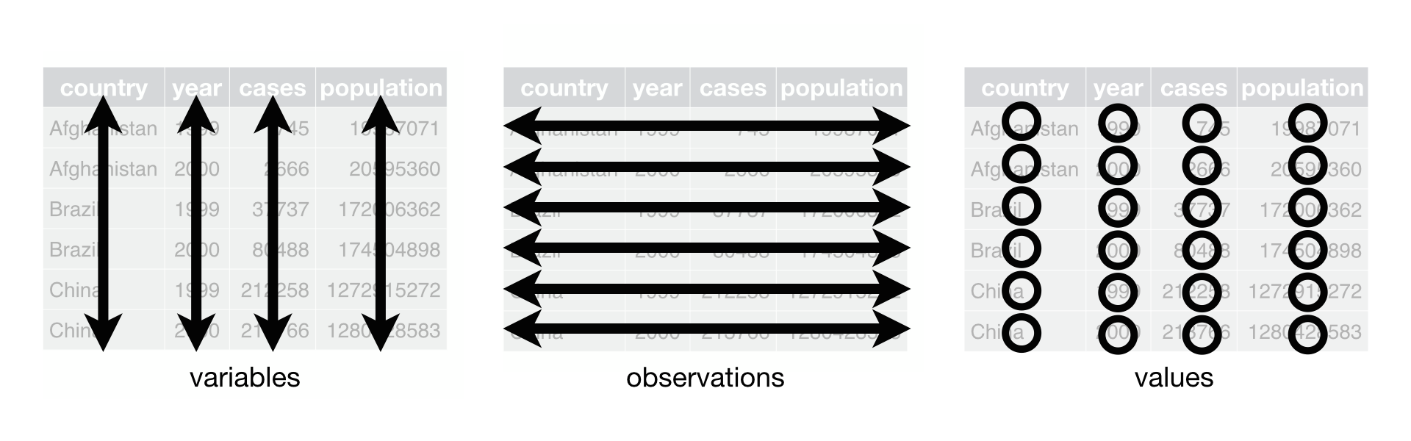
How is genomics data organized? - students response
columns
 | Each row represents | Columns | Values
metadata | Cell lines | DepMap_ID, Age, Disease, Subtype, Location where it was collected, How it is being stored, Sex of person it came from, CRISPR information! | “ACH-00001”, 28, “carcinoma”, “melanoma”, ….
mutation | Specific mutation on a gene of a specific cell line | Chr, Start, end position, strand, type of mutation | Chr12, 2342342, 2342345, +, “Silent”
expression | Cell lines | DepMap_ID, specific genes | “ACH-00001”, 2.3 (expression of a gene)
Notes:
Breakout groups: Each group explore CCLE datasets and report back what they see in the data. Do you notice any interesting trends? “Exploratory Data Analysis”
https://docs.gdc.cancer.gov/Encyclopedia/pages/Mutation_Annotation_Format_TCGAv2/
Interesting columns to focus on:
Variant_Classification
Gene_Symbol
Variant_Type

Slide 7
How is genomics data organized? - Chris
columns
 | Each row represents | Columns | Values
metadata | Cell lines | Age, primary disease, Depmap_ID | 28, “leukemia”, ACH-000986”
mutation | Mutation (of a specific gene’s location and cell line) | chromosome, Start_position, Depmap_ID | 19, 58858867, “ACH-000986”
expression | Cell lines | Depmap_ID, Gene1, Gene2, Gene3 | “ACH-000986”, 10, 12, 8
Notes:
Mutations are tricky, because you can see gene’s mutation 500 times, coming from different parts of the gene and/or coming from different cell lines.

Slide 8
A well-wrangled dataframe
DepMap_ID Gene A Mutation Gene B Expression Subtype ...
Cell Line 1
Cell Line 2
Cell Line 3
...
Notes:
Often, this is the format we want - our observations are about samples/cell lines
How do we get our dataframe in the right format for the appropriate analysis?

Slide 9
For the biological question I have, what are the needed observations and columns that answer the question?
We might not have the needed observations and columns together in the same dataframe.
4 important scenarios that are useful for most data wrangling tasks:

Slide 10
“The rows and columns I need can be subsetted.”
Explicit and implicit subsetting on dataframes, which we know already…
Subset iris by rows so that the Sepal.Length <= 2.
Subset iris by columns to only have “Sepal.Length” and Sepal.Width” columns.
Notes:
Maybe we should decide as a class whether we are sticking to base-R or Tidyverse for subsetting.
Boolean vector comes from comparison operators.
Subset to Hugo_Symbol == “KRAS”, Depmap_ID == “ACH-000463”
mutation[mutation$Hugo_Symbol == “KRAS” & mutation$Depmap_ID == “ACH-000463” , ]

Slide 11
“The observations and columns I need can be subsetted.”
Implicit subsetting on dataframes, which we know how to do already in base R!
An alternative:
Subset by columns in Tidyverse:
select(df, column_name1, column_name2, ...)
Subset by rows in Tidyverse:
filter(df, logical_indexing_vector)
Note: the second argument for select() does not take in variables in the environment. We specify column names defined in in df. These are called data variables.
Notes:
Maybe we should decide as a class whether we are sticking to base-R or Tidyverse for subsetting.
Boolean vector comes from comparison operators.
Subset to Hugo_Symbol == “KRAS”, Depmap_ID == “ACH-000463”
mutation[mutation$Hugo_Symbol == “KRAS” & mutation$Depmap_ID == “ACH-000463” , ]

Slide 12
2. “The column I want is an operation or function of other columns I already have in the dataframe.”
iris$Sepal.Area = iris$Sepal.Width * iris$Sepal.Length
iris$isSetosa = iris$Species == “setosa”
Notes:
Assignment by entire vectors

Slide 13
3. “The columns that I need are in two different dataframes with a common column. The rows of both dataframes represent the same thing.”
DepMap_ID | primary_disease
ACH-000001 | Ovarian Cancer
ACH-000002 | Leukemia
ACH-000003 | Colon/Colorectal Cancer
ACH-000004 | Leukemia
DepMap_ID | TSPAN6
ACH-000001 | 5.82
ACH-000002 | .18
ACH-000003 | 6.03
ACH-000004 | 2.59
DepMap_ID | primary_disease | TSPAN6
ACH-000001 | Ovarian Cancer | 5.82
ACH-000002 | Leukemia | .18
ACH-000003 | Colon/Colorectal Cancer | 6.03
ACH-000004 | Leukemia | 2.59

Slide 14
3. “The columns that I need are in two different dataframes with a common column. The rows of both dataframes represent the same thing.”
DepMap_ID | primary_disease
ACH-000001 | Ovarian Cancer
ACH-000002 | Leukemia
ACH-000003 | Colon/Colorectal Cancer
ACH-000004 | Leukemia
DepMap_ID | TSPAN6
ACH-000001 | 5.82
ACH-000002 | .18
ACH-000003 | 6.03
ACH-000004 | 2.59
DepMap_ID | primary_disease | TSPAN6
ACH-000001 | Ovarian Cancer | 5.82
ACH-000002 | Leukemia | .18
ACH-000003 | Colon/Colorectal Cancer | 6.03
ACH-000004 | Leukemia | 2.59
inner_join(df1, df2, "DepMap_ID")

Slide 15
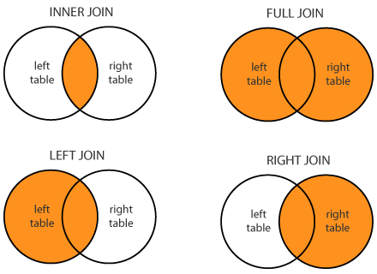
Variations of join
Different variations of join can happen when you merge datasets with different number of observations.
*_join(metadata_sm, expression_sm, "DepMap_ID")
Notes:
Common variable/observation

Slide 16
DepMap_ID | primary_disease
ACH-000001 | Ovarian Cancer
ACH-000002 | Leukemia
ACH-000003 | Colon/Colorectal Cancer
ACH-000004 | Leukemia
DepMap_ID | TSPAN6
ACH-000001 | 5.82
ACH-000002 | .18
ACH-000003 | 6.03
ACH-000005 | 2.59
DepMap_ID | primary_disease | TSPAN6
ACH-000001 | Ovarian Cancer | 5.82
ACH-000002 | Leukemia | .18
ACH-000003 | Colon/Colorectal Cancer | 6.03
ACH-000004 | Leukemia | NA
ACH-000005 | NA | 2.59
full_join(df1, df2, "DepMap_ID")

Slide 17
4. “The rows representation I want is described by a column. The columns I want need to be summarized.”
species | Sepal.Length | Sepal.Width
setosa | 2 | 3
setosa | 4 | 2
virginica | 1 | 2
virginica | 2 | 1
species | Mean.Sepal.Length | Mean.Sepal.Width | n
setosa | 3 | 2.5 | 2
virginica | 1.5 | 1.5 | 2
Observation: plants
Columns: species, sepal length, and width for each plant
Observation: species
Columns: mean sepal length and width for plants observed, number of plants observed for each species.
Notes:
This is tricky because for each species, we have multiple observations of plants associated with it.
So to have species as a observation, we need to “summarize” down our variables.

Slide 18
4. “The rows representation I want is described by a column. The columns I want need to be summarized.”
species | Sepal.Length | Sepal.Width
setosa | 2 | 3
setosa | 4 | 2
virginica | 1 | 2
virginica | 2 | 1
species | Mean.Sepal.Length | Mean.Sepal.Width | n
setosa | 3 | 2.5 | 2
virginica | 1.5 | 1.5 | 2
summarize(group_by(iris, species),
Mean.Sepal.Length = mean(Sepal.Length),
Mean.Sepal.Width = mean(Sepal.Width),
n = n())
Notes:
Summarize is like mutate, but it responds to a grouping indicator.
Other summarizing functions:
median(), n(), n_distinct(), any(), all(), sd()
CCLE metadata example:

Slide 19
4. “The rows representation I want is described by a column. The columns I want need to be summarized.”
Hugo_Symbol | DepMap_ID | Chr | Position
KRAS | ACH-000001 | 12 | 25..257
EGFR | ACH-000001 | 12 | 25..263
TP53 | ACH-000001 | 12 | 25..853
KRAS | ACH-000002 | 12 | 25..257
DepMap_ID | n_mutated
ACH-000001 | 3
ACH-000002 | 1
Rows represent: variant
Columns: Hugo_Symbol, DepMap_ID, Chr, Position
Rows represent: cell line (DepMap_ID)
Columns: number of mutations

Slide 20
4. “The observation I want is described by other columns. The columns I want need to be summarized.”
Hugo_Symbol | DepMap_ID | Chr | Position
KRAS | ACH-000001 | 12 | 25..257
EGFR | ACH-000001 | 12 | 25..263
TP53 | ACH-000001 | 12 | 25..853
KRAS | ACH-000002 | 12 | 25..257
DepMap_ID | n_mutated
ACH-000001 | 3
ACH-000002 | 1
summarize(group_by(mutation_sm, DepMap_ID), n_mutated = n())

Slide 21
Data wrangling: What are some tools to check that I did it right?

Slide 22
Data wrangling: What are some tools to check that I did it right?
ncol()
nrow()
head()
tail()
is.na()

Slide 23
NA’s
They occur when a value is missing from the dataset, or when the operation you perform generates a value that is unknown.
Use is.na() to get a boolean vector of whether a vector contains NA.
> is.na(c(NA, 2, 3, 4, NA, NA, 5, 6))
How do we subset metadata by rows so that it has NAs for age?

Slide 24
What is the number of TP53 mutations for each cell line?
Which of the three datasets do we need?
What are the observation and columns we have to work with?
What is the final dataframe observations and columns we need?
How can the data wrangling steps be broken down into the 4 types of questions we have?
Notes:
TP53_mutation = mutation_sm[mutation_sm$Hugo_Symbol == "TP53" ,]
TP53_mutation_cellline = summarize(group_by(TP53_mutation, DepMap_ID), N_TP53_Mut = n())
#or
# X = summarize(group_by(mutations, Hugo_Symbol & DepMap_ID), n_mutations = n())

Slide 25
What is the mean number of TP53 mutations for each cancer type?
Which of the three datasets do we need?
What are the observation and columns we have to work with?
What is the final dataframe observations and columns we need?
How can the data wrangling steps be broken down into the 4 types of questions we have?
Notes:
VHL_mutations = filter(mutations, Hugo_Symbol == "VHL")
VHL_mutations_cellline = summarize(group_by(VHL_mutations, DepMap_ID),
VHL_mutations = n())
metadata_VHL_mutations = inner_join(metadata, VHL_mutations_cellline, by = "DepMap_ID")
summarize(group_by(metadata_VHL_mutations, primary_disease), mean_VHL_mutations = mean(VHL_mutations))

Slide 26
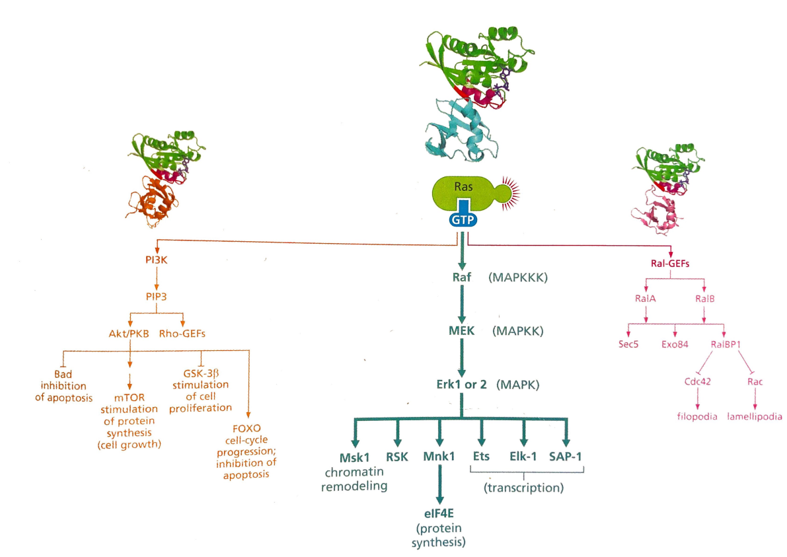
Studying KRAS oncogene
Notes:
Will talk about how people found oncogenes such as KRAS on Friday.
KRAS is downstream of EGFR.
EGFR is the epidermal growth receptor with tyrosine kinase domains that to conduct signaling to other tyrosine kinases in the cytoplasm via phosphorylation. Two receptors come together that bind to ligands on the cell surface.
KRAS is a driver oncogene.
It is like a binary switch, using a GTP-GDP cycle to flip an on and off switch. Guanine nucleotide exchange factors (GEFs) activate it by replacing GDP to GTP, and Ras has an intrinsic GTPase protein subunit that inactivates it.
Mutations hit the GTPase function of Ras, letting it stay in GTP active phase.
KRAS drives 32% of lung cancers, 40% of colorectal cancers, and 85% to 90% of pancreatic cancer cases.

Slide 27
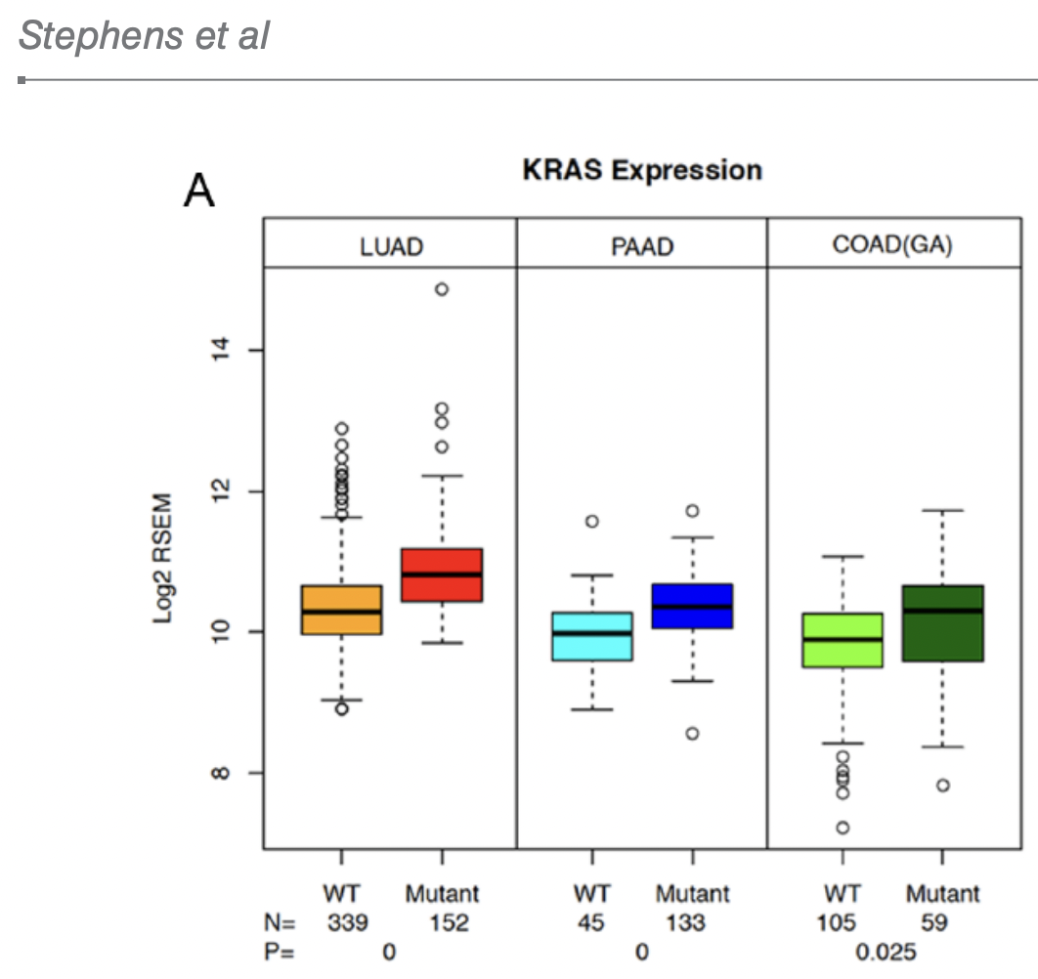
Studying KRAS oncogene...computationally!
Notes:
Min, Q1, median, Q3, max
TCGA, CCLE

Slide 28
biological question <-> computational analysis
samples → variants → genes → cell types → processes → disease
Is mutation of gene X associated with gene X’s own expression?

Slide 29
Additional Resources
Introduction to Tidyverse, Sections 1, 3: Data wrangling, Grouping and summarizing. There are some functions such as filter() that we didn’t cover. https://learn.datacamp.com/courses/introduction-to-the-tidyverse
R for Data Science, Chapter 12. There are some functions such as filter() that we didn’t cover. https://bookdown.org/rdpeng/rprogdatascience/managing-data-frames-with-the-dplyr-package.html

Slide 30
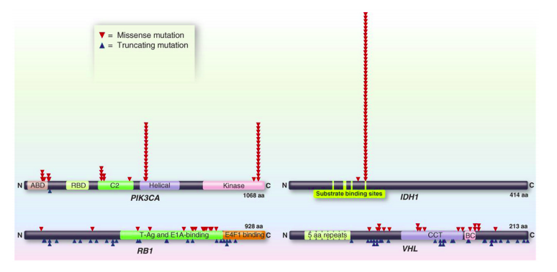
What is the most common position of IDH1 mutations?
Notes:
mutations$unique_position = paste0(mutations$Chromosome, mutations$Start_position)
IDH1_mutations = filter(mutations, Hugo_Symbol == "IDH1")
result = summarize(group_by(IDH1_mutations, Start_position, Chromosome), n_mutations = n())

Slide 31

The pipe as an alternative to nested functions
result = function3(function2(function1(df), arg2 = True)) | result = df %>% function1 %>% function2(arg2 = True) %>% function3
summarize(group_by(iris, Species), Mean.Sepal.Length = mean(Sepal.Length), Mean.Petal.Length = mean(Petal.Length), n = n()) | iris %>% group_by(Species) %>% summarize(Mean.Sepal.Length=mean(Sepal.Length),Mean.Petal.Length=mean(Petal.Length))
Notes:
Rewrite the the code we presented via pipes.
You will see this in Datacamp.

